Slide 1
Police measures

Slide 2
A police measure is an action or set of actions of a preventive or coercive nature that limits certain rights and freedoms of a person and is used by the police in accordance with the law to ensure the fulfillment of the powers assigned to the police.

Slide 3
The police measure is used exclusively for the execution of police powers. The chosen police measure must be legal, necessary, proportionate and effective.
The chosen police measure is legal if it is defined by law. The police officer is prohibited from applying any measures other than those defined by the laws of Ukraine.

Slide 4
The chosen police measure is necessary if it is impossible to apply another measure for the execution of police powers or its application will be ineffective, and also if such a measure will cause the least harm both to the addressee of the measure and to other persons.
The applied police measure is proportionate if the harm caused to the rights and freedoms of a person protected by the law or the interests of society or the state does not exceed the good for the protection of which it is applied or the created threat of harm

Slide 5
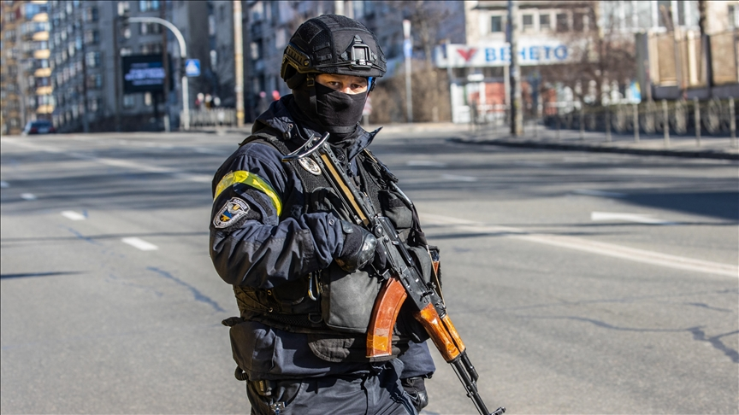
The chosen police measure is effective if its application ensures the fulfillment of police powers.
A police measure is terminated if the goal of its application is achieved, if the impossibility of achieving the goal of the measure is obvious, or if there is no need for further application of such a measure.

Slide 6
Types of police measures:
In order to fulfill the tasks assigned to it, the police takes measures to respond to offenses defined by the Code of Ukraine on Administrative Offenses and the Criminal Procedure Code of Ukraine, on the basis and in the manner determined by law.
The police, in order to protect human rights and freedoms, prevent threats to public safety and order or stop their violation, also applies police preventive measures and coercive measures defined by this Law within the limits of their competence.
The police may apply other measures defined by separate laws to fulfill the tasks assigned to it.
If the policeman cannot be identified by external features, he is obliged to show the person a document certifying his authority

Slide 7
Thank you for your attention)

