Slide 1
General characteristics of state legal policy

Slide 2


According to the Constitution of Ukraine, a person, his life and health, honor and dignity, inviolability and security are recognized as the highest social value in our country. The main efforts of the state authorities of Ukraine, primarily the judiciary, are aimed at achieving this goal and guaranteeing human rights and freedoms.

Slide 3

Legal policy
is one of the most important types of state policy. That is why it is impossible to understand the essence of legal politics without knowing what politics is in general. Modern political scientists, relying on the thinkers of the past, emphasize that politics is also the art of the possible, the art of compromises, the reconciliation of the desired and the objectively achievable.

Slide 4

Legal policy as an applied science is designed to determine the current legislation and contribute to the development of a more perfect law.

Slide 5

Legal policy is a special form of expression of state policy, it is a means of legal legitimation, consolidation and implementation of the political course of the country and state authorities.

Slide 6
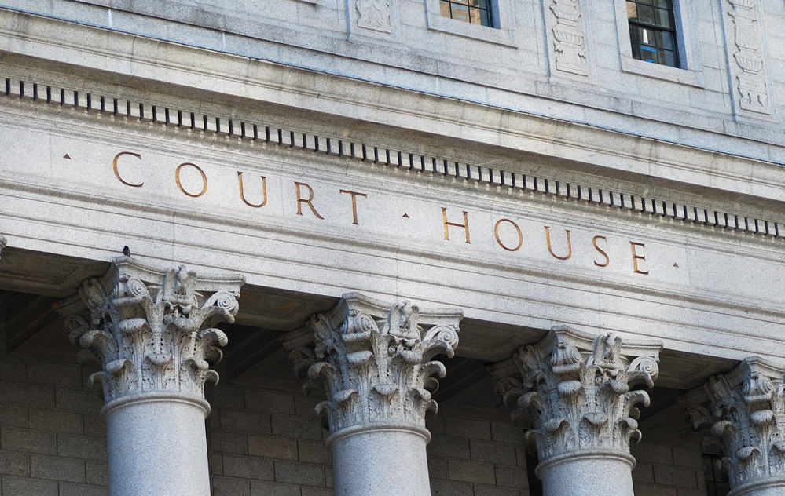
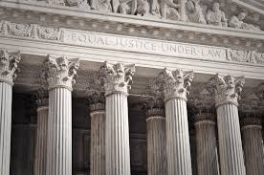
Legal policy is primarily a legal category, i.e. the most general typical concept used in law, it is a means of constructing and understanding law as a systemic entity for regulating social relations, i.e. interconnected with the legal system in general.

Slide 7

State legal policy is the principles, strategic directions and ways of creating and implementing legal norms based on general and specific patterns of development of the national legal system, it is the activity of subjects of the political system aimed at ensuring the rights and freedoms of man and citizen.

Slide 8



Today, the main task of the state legal policy is the regulatory and legal support of reforms.

Slide 9

The main principles of legal policy, on the basis of which it should be developed and implemented, are: the priority of human rights as the highest social value; social conditioning; justice; legitimacy and democratic nature; compliance with the main provisions of the legislation of the European Union and international law; publicity; scientific validity; stability and predictability.

Slide 10
Thanks for your attention!

